Slide 1

Handwriting Detection

Slide 2
Introduction
Handwriting recognition (HWR) technology has been an active area of research for many years, and recent advances in machine learning have greatly improved its accuracy.
HWR technology allows computers to recognize and transcribe handwritten text into machine-readable formats, enabling businesses to digitize large amounts of data quickly and accurately.
The development of HWR technology has been driven by the growing demand for digitization across many industries. In the enterprise sector, HWR can be used to digitize handwritten notes, forms, and documents, making them easier to store, search, and analyze.
In the field services industry, HWR can be used to digitize work orders, field reports, and other handwritten documents, improving the speed and accuracy of data collection. In healthcare, HWR can be used to digitize medical records and patient notes, making them easier to share and analyze.

Slide 3
What is handwriting recognition?
Handwriting recognition (HWR) refers to the ability of computers or mobile devices to interpret and convert handwritten input into digital text. This technology allows people to write naturally using pen and paper or a stylus, and then have their handwriting recognized and transcribed into machine-readable formats. Handwriting recognition can be done offline, by scanning handwritten documents or images, or online, by sensing the movements of a pen on a digitizer. HWR systems also involve formatting, segmentation into individual characters, and training a language model to form meaningful words and sentences.

Slide 4
Benefits of handwriting recognition
Increased Efficiency
Improved Accuracy
Cost Savings
Better AccessibilityImproved Customer Experience

Slide 5
Industry use cases
Banking and Finance
Healthcare
Education
Retail
Legal

Slide 6
Methods of handwriting recognition
Optical Character Recognition (OCR)
Neural Networks
Hidden Markov Models (HMM)
Support Vector Machines (SVM)

Slide 7
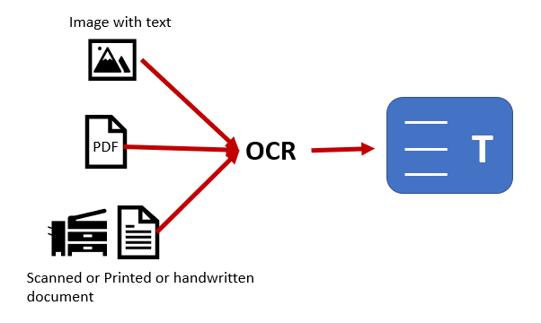
Optical Character Recognition (OCR)
OCR is a popular method for HWR that involves scanning handwritten documents and then using computer vision techniques to convert the text into machine-readable format. OCR typically involves pre-processing steps to remove noise, segment individual characters, and classify them using pattern recognition algorithms.

Slide 8
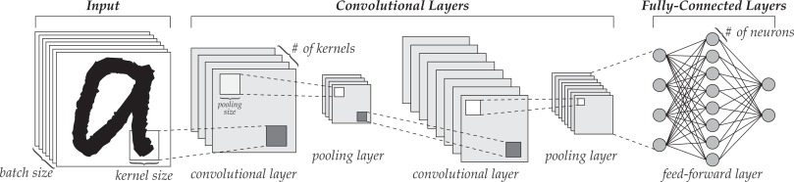
Neural Networks
Neural networks are machine learning algorithms that can be used for HWR. They work by training a network on a large dataset of handwriting samples, which allows the network to learn the patterns and variations in handwriting. Once trained, the network can then be used to recognize new handwriting inputs.

Slide 9
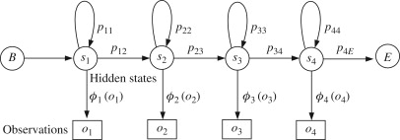
Hidden Markov Models
HMMs are statistical models that can be used for HWR. They work by modeling the probability of a sequence of handwriting strokes or characters, and then using this model to recognize new handwriting inputs.

Slide 10
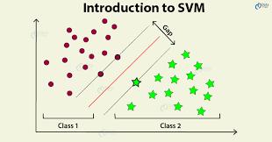
Support Vector Machines
SVMs are a type of machine learning algorithm that can be used for HWR. They work by identifying a boundary or hyperplane that separates the different classes of handwriting input, and then using this boundary to classify new inputs.

Slide 11
Challenges of Handwriting recognition
Variability of Handwriting
Quality of Input Data
Linguistic Diversity
Computational Complexity
Cost and Availability

Slide 12

Conclusion
Handwriting recognition technology can improve efficiency, accuracy, and accessibility, while also reducing costs and improving the customer experience for businesses and organizations.
There are several methods of handwriting recognition, Overall, these methods can be used alone or in combination to achieve high levels of accuracy in handwriting recognition. The choice of method depends on the specific use case, dataset, and desired level of accuracy.
Despite recent advances in handwriting recognition (HWR) technology, there are still several challenges that need to be addressed to improve its accuracy, effectiveness, and accessibility.

